Slide 1
Predicting NBA Daily Fantasy Scores
Mike Luther

Slide 2
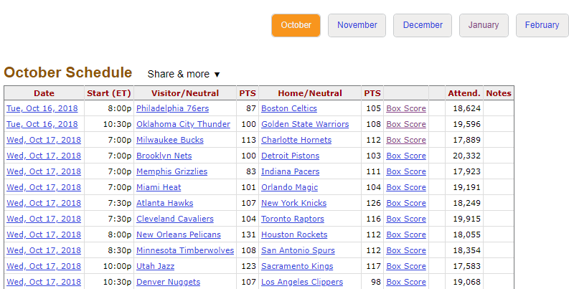
Getting the data
There is no one source where all data from NBA games can be exported to Excel
Time to get scraping!
basketball-reference.com has box score statistics for each game of a given NBA season:

Slide 3
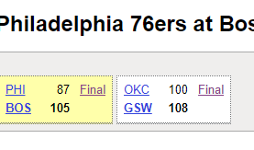
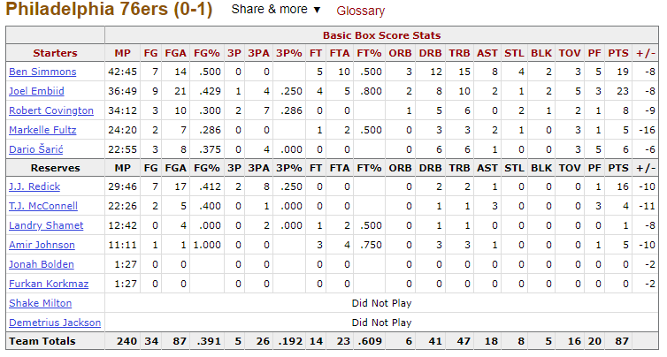
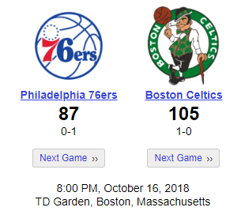
Scraping data
Clicking on “Box Score” brings you to a separate page
There are multiple elements on the page that are important for the scraping:
This element helps grab the box scores for each team below. We also use these to determine the opposing team for players in a given game.
An example of a box score for one of the teams in a game. Using beautiful soup, this can be read into a “list of dataframe objects.” Accessing [0] of this list will get the dataframe itself. Then, concatenate this score and the other box score of the game for each game.
Grab the date for each game, This is important for grouping the data later on

Slide 4
The data – basic features And cleaning
Over 24,000 unique observations.
506 different players.
BeautifulSoup read the html all in as a string – so even the columns containing numbers are stored in a pandas dataframe as strings.
Convert those to numeric
If a player did not play, each column in that row said either “Did Not Play”, “Did Not Dress”, or “Not With Team”
Those rows were removed

Slide 5
Feature creation
First, we need to calculate the fantasy points scored. DraftKings standard game scoring was used.
What variables do we want to use as predictors?
We need to use previous game performance – otherwise, we need to predict each statistic and then from those calculate that game’s performance
Lagged values from previous 5 games played
Average fantasy points scored up to that game
Opposing team
How do we do this?

Slide 6
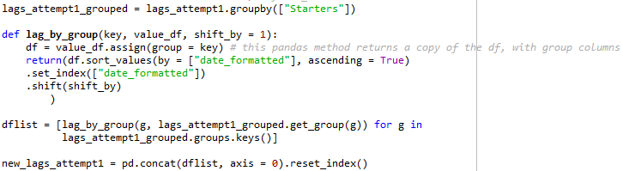
Lagged Values
First, convert date as a string to a datetime object for grouping purposes
Then, group the dataframe by unique players

Slide 7
Average fantasy points scored going into current game
The logic:
First create a function to count games played for each player
Calculate running total of points for each player
Divide that by games played
Shift column down one row

Slide 8
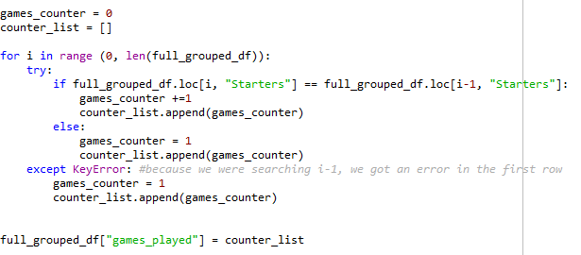
Creating lagged values and moving averages
Games counter
Running sum of points by player
Now, all that needs to be done is to divide this cumulative sum column by the games counter column, and shift it down one using .shift(1)

Slide 9
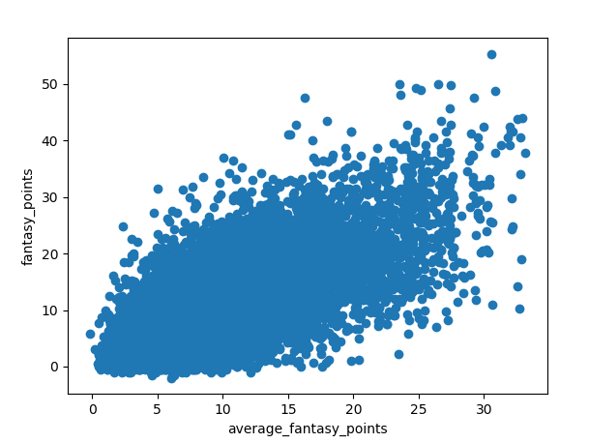
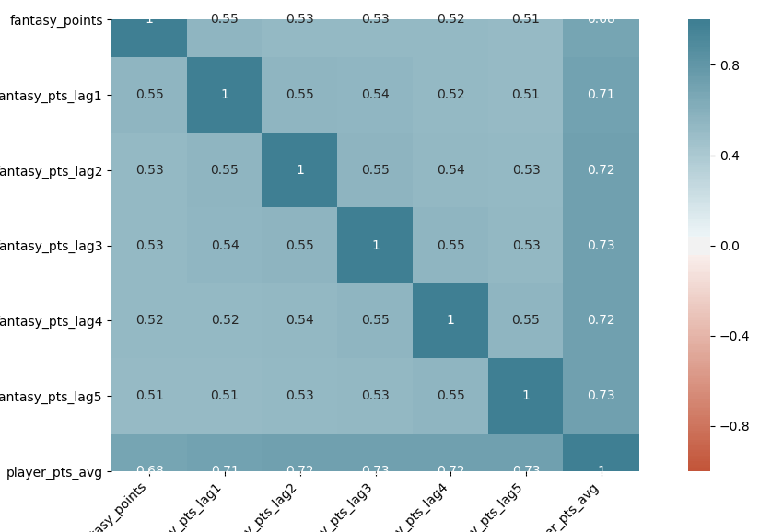
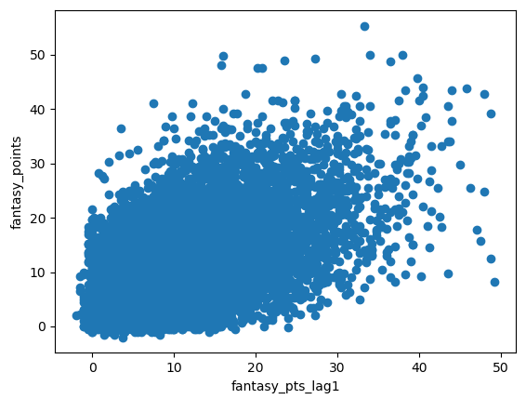
Some Visuals on the data

Slide 10
Model building
Test 3 main types of models:
Linear Regression with all predictors
Lasso Model
Neural Network

Slide 11
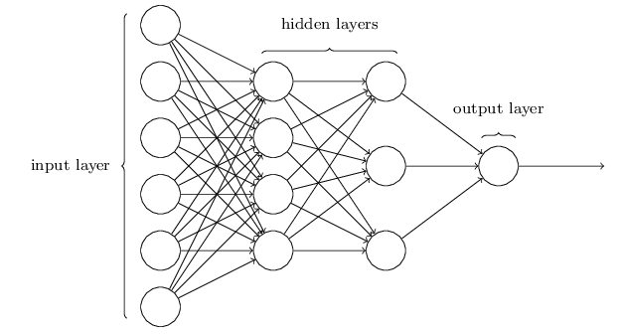
Neural network overview

Slide 12
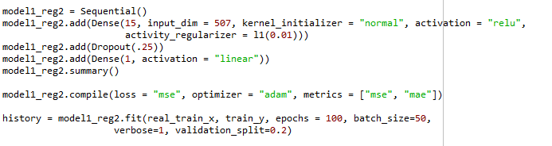
My neural network
The code
What’s happening
Line 1: sequential indicates a linear stack of layers.
Line 2:
Creates15-neuron hidden layer from 507 input neurons
Kernal initializer = “normal” uses a normal distribution to initialize weights.
Relu = “rectified linear activation unit”
L1 is an activity regularizer.
Line 3: adds a 25% chance of dropping a given neuron each iteration through the data.
Line 4: Adds our output layer. A linear activation can be thought of as an identity activation function.
Line 6: .compile configures the model for training. We specify what metric we use to optimize our loss function. “adam” is a stochastic gradient-based optimization method, similar to stochastic gradient descent.
Final line: fitting the data to our train set.
Epochs: how many forward and backward passes we are training our model over

Slide 13
The winning model
Linear model with all predictors was the most accurate on the test data
MAE of 4.12 (the MAE of the lasso model was 4.14, the MAE of the best neural network model was 4.24)
The best MAE the Stanford people got was 6.603 – take that, nerds!
What do we make of this?
All variables linearly related
Hope was that the neural network would help choose weights for each lag
For something like this, prediction accuracy is our only goal – even though the correlated predictors will bias our coefficients, we are not concerned with the coefficients – just the outcome.
Perhaps the neural network will help with in future work when we add more complicated variables…

Slide 14
Future work – applying the model
Build program to select best lineup
Would need to scrape cost each day from DraftKings website
Write program to optimize lineup given each player’s cost while following positional lineup requirements
What other data could be useful in making a model?
If they did not play in recent game(s)– why did they not play?
Players may play better than their averages after a day of rest
Players may play worse than their averages after coming back from injury
More information on player’s team
Are they missing teammates due to injury or rest?
If they are missing a high-scoring teammate, they may score more in his place
More information on the opposing team
Average defensive stats
Available players on roster – what if opponent has injured starters or is resting players?

